Slide 1
RESTAURANT MANAGEMENT SYSTEM USING ASSEMBLY LANGUAGE PROGRAMMING
GROUP NO - 3
19BCB0086 - Arshdeep Singh
19BCE0875 - Shreyas Nair
19BCE0774 - Shreyas Chaudhry
19BCE2259 - Tejas Jonnadula
19BCE2575 - Krishna Jaiswal

Slide 2
ABSTRACT
With the modernization, the restaurant culture is increasing day by day. Everyone prefers to go to an outlet and eat there especially on weekends . With the increase in the demand for the restaurant culture the possibility of the human error and wastage of time also increases . Due to limited amount of staff available to service it could lead to a lot of wastage of time . This has led to long queues and waiting time . In this project we are designing , developing and testing an assembly language code program to be used in a restaurant generally referred as restaurant management system . This software is built on 8086 and hence it has very little to no need of specialized hardware and can perform tasks very quickly and accurately.Such a system is portable lightweight and easy to mass-produce thus having a huge scope in small scale restaurants

Slide 3
LITERATURE SURVEY
S NO | TITLE | ADVANTAGES | DISADVANTAGES
1. | Using Video Game Development to Engage Undergraduate Students of Assembly Language Programming | -The paper helps us to know that assembly programme has gathered large interests among peers. -Also helped us to know that application based projects can be made in assembly, because they have shown pictures of the basic pacman games, and tetris, etc. | -Just a survey based paper, no such technical thing involved in the paper, also not given in detail about the technical aspect involved in video game making using assembly language

Slide 4
LITERATURE SURVEY
2. | Microprocessor-Based Controller for Pharmacodynamical Applications | -An efficient controller is made using microprocessor (Motorola 6800) for injecting medicine into the blood. -microprocessor based controller can also be used for other pharma base applications. | -accuracy concerns, also the Motorola 6800 is an old processor and newer microprocessors are available which could provide more new features.
3. | The case for assembly language programming | -Explained regarding all the aspects of assembly language programming in detail | -No specific mention in relation to the programming aspects required for certain applications like video basic video game making and other projects,etc.

Slide 5
LITERATURE SURVEY
4. | Application of EMU8086 in the Teaching of Microcomputer Theory and Interface Technology | -the paper mentions regarding the use of emu8086 software for better understanding of all aspects including addressing modes, -Gives a good idea regarding the software | -no mention regarding the accuracy anywhere in the paper and also the reliability
5. | Microprocessor-based system for automatic measurement of concrete resistivity | -Another field of application where microprocessor based systems can be used and have been explored. | -no mention regarding the accuracy anywhere in the paper and also the reliability.

Slide 6
LITERATURE SURVEY
6. | Effective Instruction Fetch Stage Design for 16-bit Instruction Set Architecture | -This paper presents a new instruction coalescing technique named as move folding to remove redundant move instructions caused by the limitation of the 16-bit instruction set | -constraint named lack of bits for intermediate values was identified by them but no solution was provided
7. | E-Restaurant: Online Restaurant Management System for Android | -this paper also provides an basic android application, here they have used the functionality of an PIC microcontroller. -new technologies ike zigbee, etc are also proposed | -no proper architecture diagram of working of the system is provided, and no mention on any further updates of the application

Slide 7
LITERATURE SURVEY
9. | The case for the reduced instruction set computer | The following paper gives us a good detailed insight on the major architectures of the computers and is greatly insightful for learning about speed and efficiency of executions | -It is related but very indirectly to our project as the paper talks more about how the ISA complexity has increased over recent years. -doesn’t consider assembly language alone.
10. | Research on Method of Mixture Programming of Assembly Language and C/C++ Language | This technical paper is a good take on comparing assembly language to a HLL like C++ for getting benefits of both types of programming language | -The paper acts as a template only -More effort to be put in while implementing it which requires further research

Slide 8
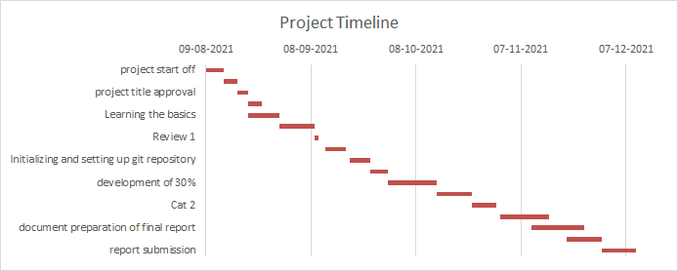
WORK FLOW PATTERN WITH TIMELINE:

Slide 9
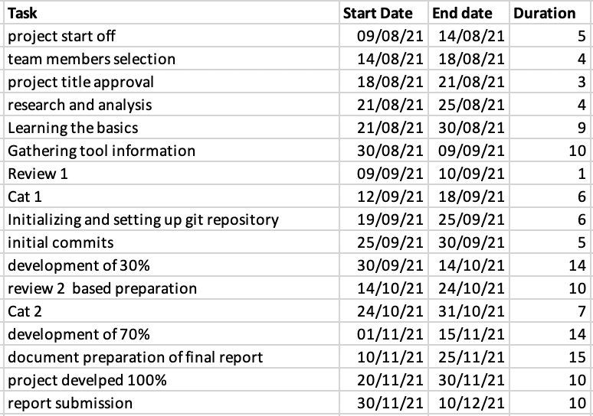
Detailed Task Layout

Slide 10
TOOLS REQUIRED
Assembler for asm
8086 chipset
Assembly language editor
A target machine on which the program shall be executed
Git and Github
Fortunately the needs of 1-3 are satisfied by the emu8086 application which has been licensed by our University.
As for the target machine it will be a windows 10 based system with the emu8086 installed in it.
Since we are a team the code shall be monitored over a remote repository on github and each of us will use git in our system to contribute to the same.

Slide 11
References
Assembly Language Mixed with C and Visual C++ Language for Programming--《Journal of Qingdao University of Science and Technology》2003年S1期. (n.d.). En.cnki.com.cn. Retrieved September 9, 2021, from https://en.cnki.com.cn/Article_en/CJFDTotal-QDHG2003S1045.htm
Kawash, J., & Collier, R. (2013). Using video game development to engage undergraduate students of assembly language programming. Proceedings of the 14th Annual ACM SIGITE Conference on Information Technology Education. https://doi.org/10.1145/2512276.2512281
Kim, A., Seok Joong Hwang, & Seon Wook Kim. (2008). Effective Instruction Fetch Stage Design for 16-Bit Instruction Set Architecture. 2008 IEEE 8th International Conference on Computer and Information Technology Workshops. https://doi.org/10.1109/cit.2008.workshops.107
Koivo, A. (1981). Microprocessor-based controller for pharmacodynamical applications. IEEE Transactions on Automatic Control, 26(5), 1208–1213. https://doi.org/10.1109/tac.1981.1102788
Loui, M. C. (1988). The case for assembly language programming. IEEE Transactions on Education, 31(3), 160–164. https://doi.org/10.1109/13.2306

Slide 12
Patterson, D. A., & Ditzel, D. R. (1980). The case for the reduced instruction set computer. ACM SIGARCH Computer Architecture News, 8(6), 25–33. https://doi.org/10.1145/641914.641917
Research on Method of Mixture Programming of Assembly Language and C/C++ Language--《Journal of Suzhou Vocational University》2012年01期. (n.d.). En.cnki.com.cn. Retrieved September 9, 2021, from https://en.cnki.com.cn/Article_en/CJFDTotal-SZSZ201201012.htm
Vinayak, Dr., Ranjan, V., Masiwal, N., & Verma, N. (2013). e-Restaurant: Online Restaurant Management System for Android. International Journal of Advanced Computer Science and Applications, 3(1). https://doi.org/10.14569/specialissue.2013.030108
Wilson, J. G., Whittington, H. W., & Forde, M. C. (1983). Microprocessor-based system for automatic measurement of concrete resistivity. Journal of Physics E: Scientific Instruments, 16(7), 700–705. https://doi.org/10.1088/0022-3735/16/7/031

